Slide 1
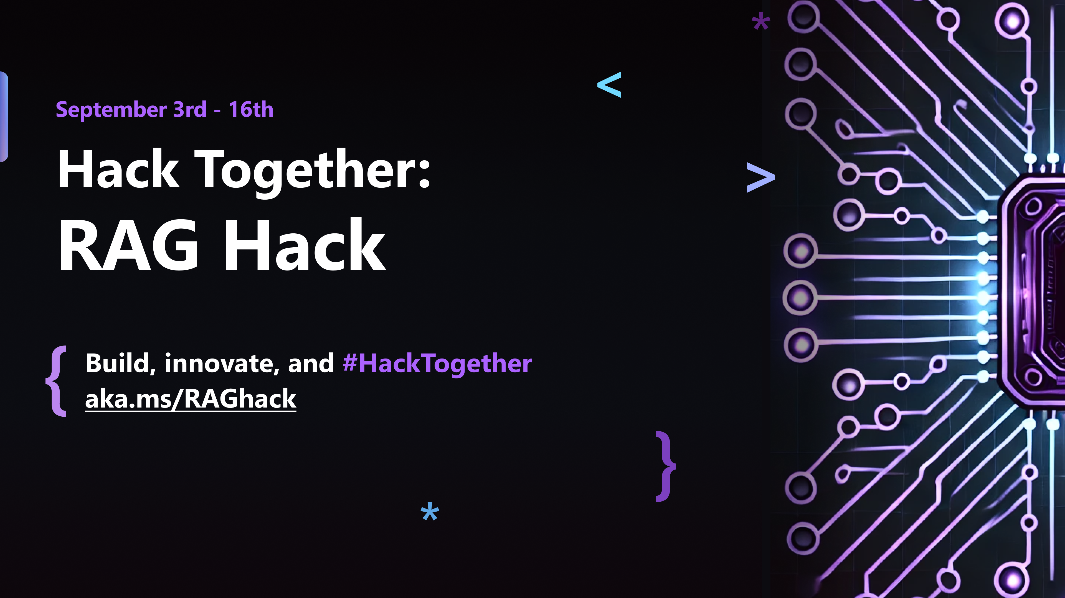

Slide 2
RAGHack streams
aka.ms/RAGhack
Week 1: September 3 - 8
9
MONDAY
3
TUESDAY
4
WEDNESDAY
5
THURSDAY
6
FRIDAY
7
SATURDAY
8
SUNDAY
RAG 101
.NET
Azure AI Studio
Python
Langchain4J
LangchainJS
Responsible AI
MongoDB
Azure AI Search
PostgreSQL
Azure SQL
GraphRAG
Multi-channels
Hack!
Hack!
Hack!
Hack!
Hack!
Hack!
Week 2: September 9 - 14
9
MONDAY
10
TUESDAY
11
WEDNESDAY
12
THURSDAY
13
FRIDAY
14
SATURDAY
15
SUNDAY
Semantic Kernel
Spring AI
Vision models
Internationalization
VSCode Agent
Agentic RAG
Code Interpreter
AI Studio Advanced
AutoGen
Data Access Control
Fine Tuning
Model catalog
Evaluations
Hack!
Hack!
Hack!
Hack!
Hack!
Hack!
Hack!
Hack!
Hack!
Submissions due September 16, 11:59 PM PT!

Slide 3
多语言支持
Spanish:
aka.ms/RagHack2024Espanol
Portuguese:
aka.ms/S-1374
Chinese:
aka.ms/S-1380
RAG: Generación Aumentada de Recuperación
Prácticas recomendadas de Azure AI Search
AI Multi-Agentes: Patrones, Problemas y Soluciones
RAG (Geração Aumentada de Busca) no Azure
Construindo RAG com Azure AI Studio e Python
Implantando RAG com .NET e Azure Developer CLI
Global RAG Hack Together
Create RAG apps with Azure AI SDK
Create RAG applications with AI Toolkit VSCode Extension
Intro to GraphRAG

Slide 4
RAGHack prizes
Best overall
Best in JavaScript/TypeScript
Best in Java
Best in .NET
Best in Python
Best use of AI Studio
Best use of AI Search
Best use of PostgreSQL
Best use of Cosmos DB
Best use of Azure SQL
Each winning team will receive a cash prize of $500 💰

Slide 5
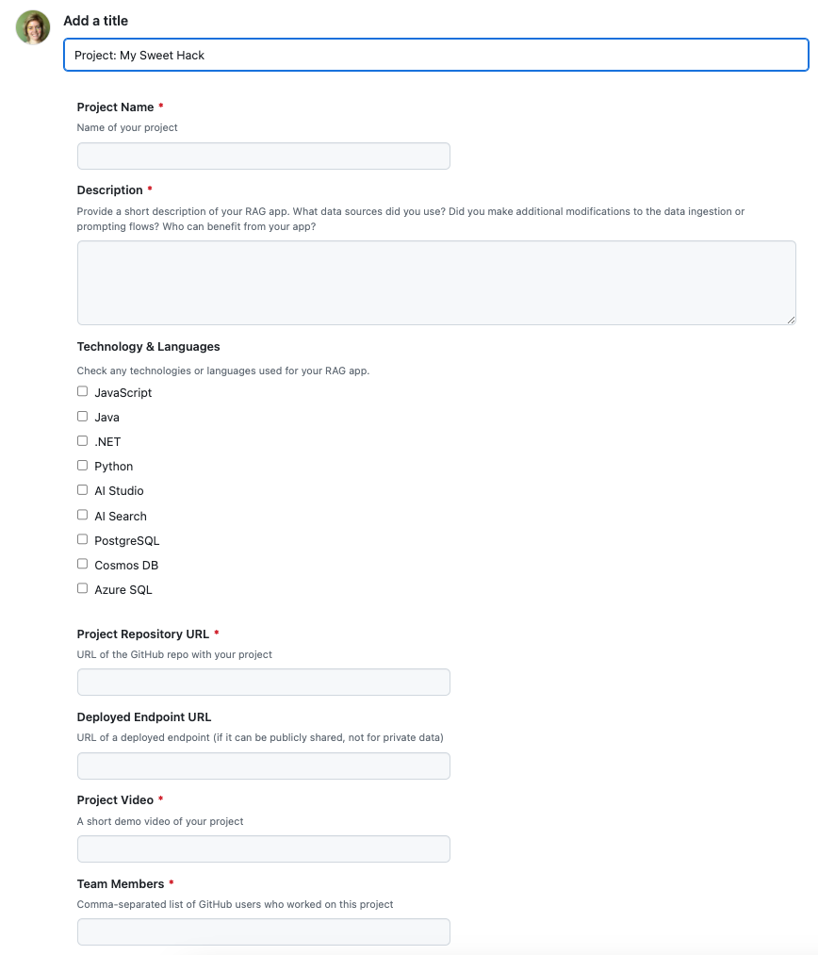
RAGHack submission process
通过注册任何 RAGHack 直播进行注册，链接如下： aka.ms/raghack/streams
太平洋时间 9 月 16 日晚上 11:59 之前，请在 aka.ms/raghack 中提交问题并填写所有字段，以提交您的 hack。项目存储库和演示视频是必需的，部署的端点是可选的。如果有团队成员，请包括他们。
等待几周让评委来评分！

Slide 6
RAG: Retrieval Augmented Generation 101
Kinfey Lo
AI Senior Cloud Advocate
github.com/kinfey

Slide 7
Agenda
What is RAG?
Simple RAG vs. Advanced RAG
RAG components
RAG solution deep dive

Slide 8
LLMs: Large Language Models

Slide 9
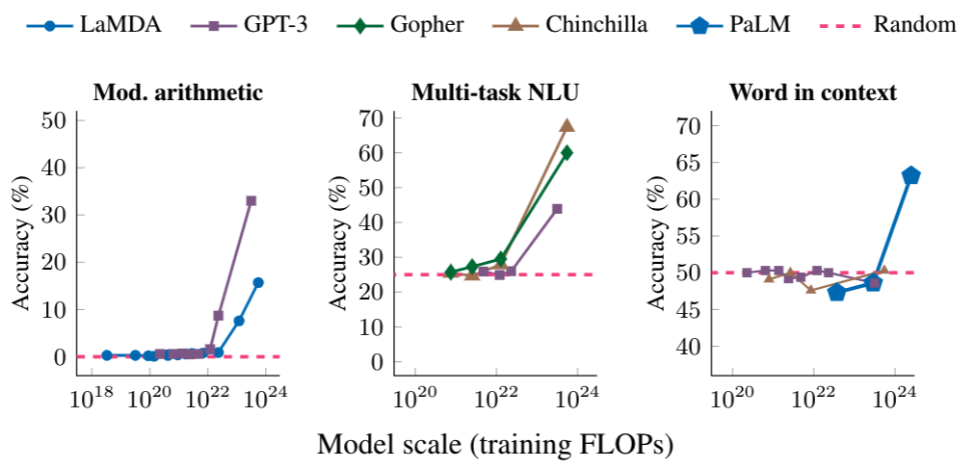
LLM: Large Language Model
LLM 是一个非常大的模型，它可以实现通用语言理解和生成。
Review: This movie sucks.
Sentiment: negative
Review: I love this movie:
Sentiment:
Input
LLM
Output
positive

Slide 10
Using LLMs on Azure
Creator | Models | How to use on Azure?
OpenAI | GPT3.5, GPT4, GPT4o, ada-002, text-embedding-3 | Azure OpenAI, GitHub Models
Microsoft | Phi-3, Phi-3mini | Azure AI Model Catalog, GitHub Models
Mistral | Nemo, Small, Large
Cohere | Command R, Command R+, Embed
Meta | LlaMA 3.1-8B, 70B, 405B
https://azure.microsoft.com/products/ai-services/openai-service
https://azure.microsoft.com/products/ai-model-catalog
https://github.com/marketplace/models

Slide 11
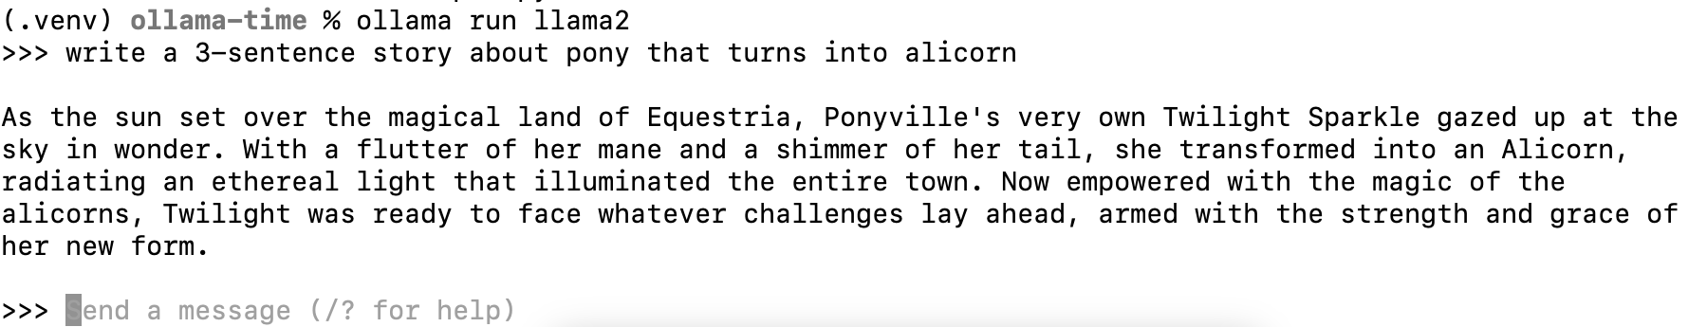
Using LLMs locally
Ollama is a tool for easily running local LLMs on your computer.
https://ollama.com/
You can also run it from GitHub Codespaces:
aka.ms/ollama-python: Ollama Python Playground

Slide 12
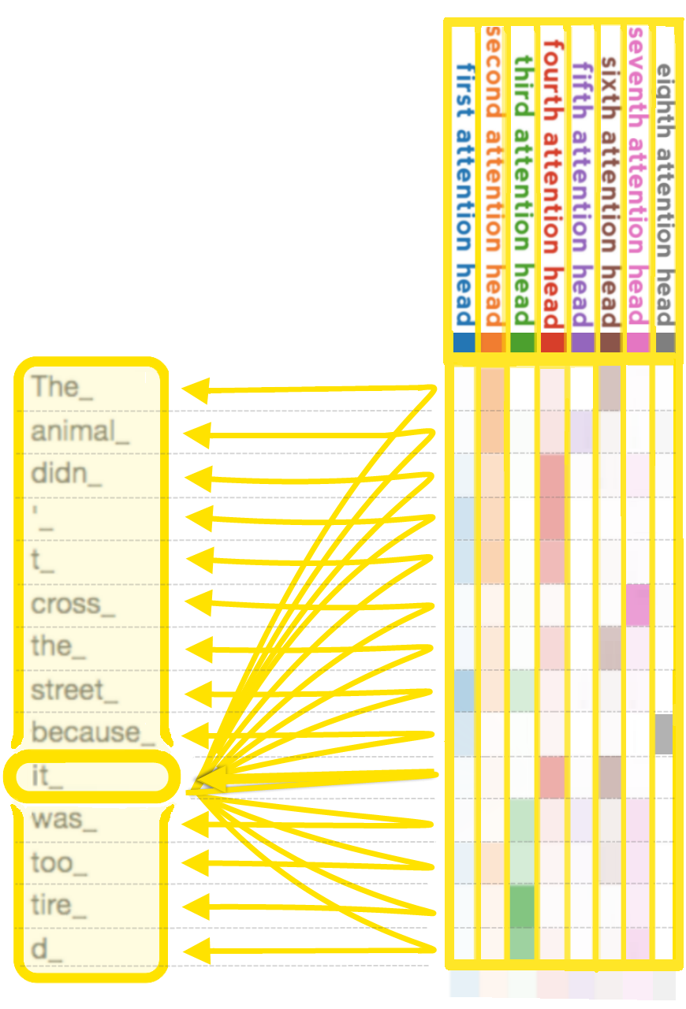
GPT: Generative Pre-trained Transformer
GPT 模型是基于 Transformer 架构的 LLM，出自
"Attention is all you need" paper
Learn more:
Andrej Karpathy: 🎥 State of GPT
Andrej Karpathy: 🎥 Let's build GPT: from scratch, in code

Slide 13
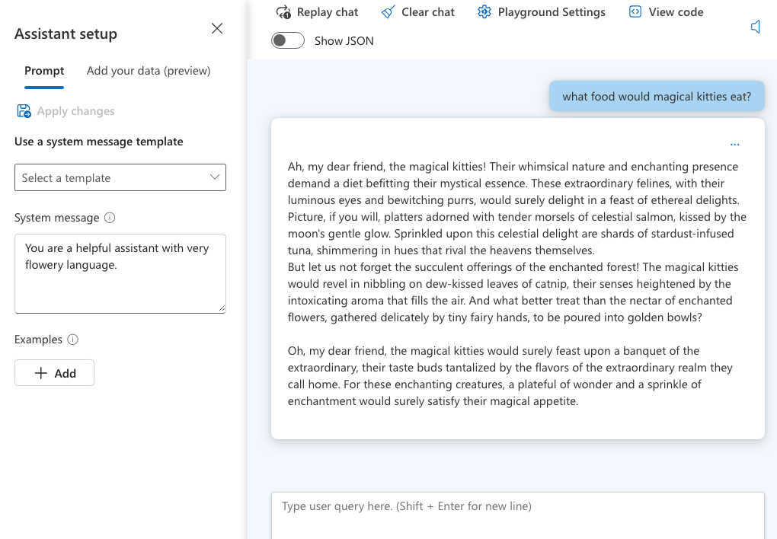
Using OpenAI GPT models: Azure AI Studio
System message
+
User question
=
Chat Completion response

Slide 14
Using LLMs from Azure OpenAI in Python
response = openai_client.chat.completions.create(
stream=True,
messages = [
{
"role": "system",
"content": "You are a helpful assistant with very flowery language"
},
{
"role": "user",
"content": "What food would magical kitties eat?”
}
])
for event in response:
print(event.choices[0].delta.content)
https://github.com/pamelafox/python-openai-demos

Slide 15
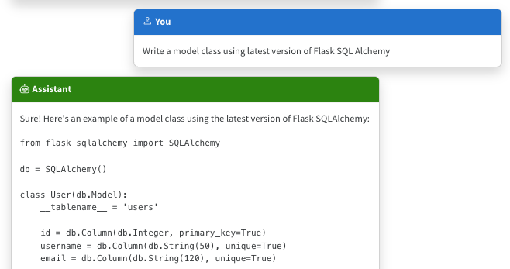
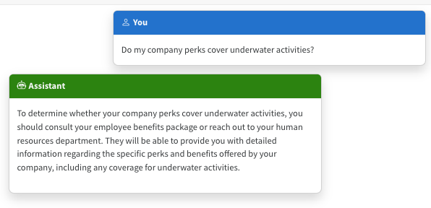
The limitations of LLMs
Outdated public knowledge
No internal knowledge

Slide 16
整合领域知识
Fine tuning
Retrieval Augmented
Generation
Learn new skills
(permanently)
Learn new facts
(temporarily)
💵 High cost, time 🕰️

Slide 17
Retrieval Augmented Generation

Slide 18




RAG: Retrieval Augmented Generation
The Prius V has an acceleration of 9.51 seconds from 0 to 60 mph.
How fast is the Prius V?
vehicle | year | msrp | acceleration |
--- | --- | --- | --- | --- | ---
Prius (1st Gen) | 1997 | 24509.74 | 7.46 |
Prius (2nd Gen) | 2000 | 26832.25 | 7.97 |
Prius (3rd Gen) | 2009 | 24641.18 | 9.6 |
Prius V | 2011 | 27272.28 | 9.51 |
Prius C | 2012 | 19006.62 | 9.35 |
Prius PHV | 2012 | 32095.61 | 8.82 |
Prius C | 2013 | 19080.0 | 8.7 |
Prius | 2013 | 24200.0 | 10.2 |
Prius Plug-in | 2013 | 32000.0 | 9.17 |
User
Question
Document Search
Large Language Model

Slide 19
RAG with OpenAI Python SDK
user_query = "How fast is the Prius V?"
retrieved_content = "vehicle | year | msrp | acceleration | mpg | class
--- | --- | --- | --- | --- | ---
Prius (1st Gen) | 1997 | 24509.74 | 7.46 | 41.26 | Compact
Prius (2nd Gen) | 2000 | 26832.25 | 7.97 | 45.23 | Compact..."
response = openai.chat.completions.create(
messages = [
{
"role": "system",
"content": "You must answer questions according to sources provided."
},
{
"role": "user",
"content": user_query + "\n Sources: \n" + retrieved_content
}
])
https://github.com/pamelafox/python-openai-demos/blob/main/retrieval_augmented_generation.py

Slide 20
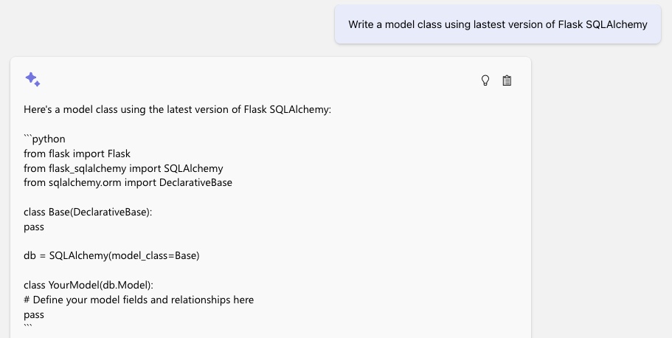
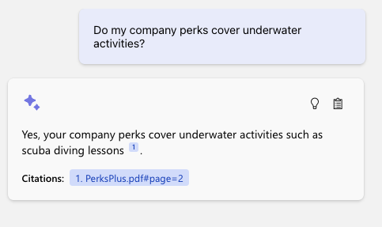
The benefits of RAG
Up-to-date public knowledge
Access to internal knowledge

Slide 21
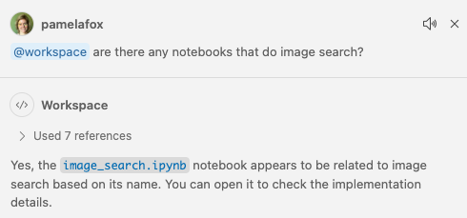
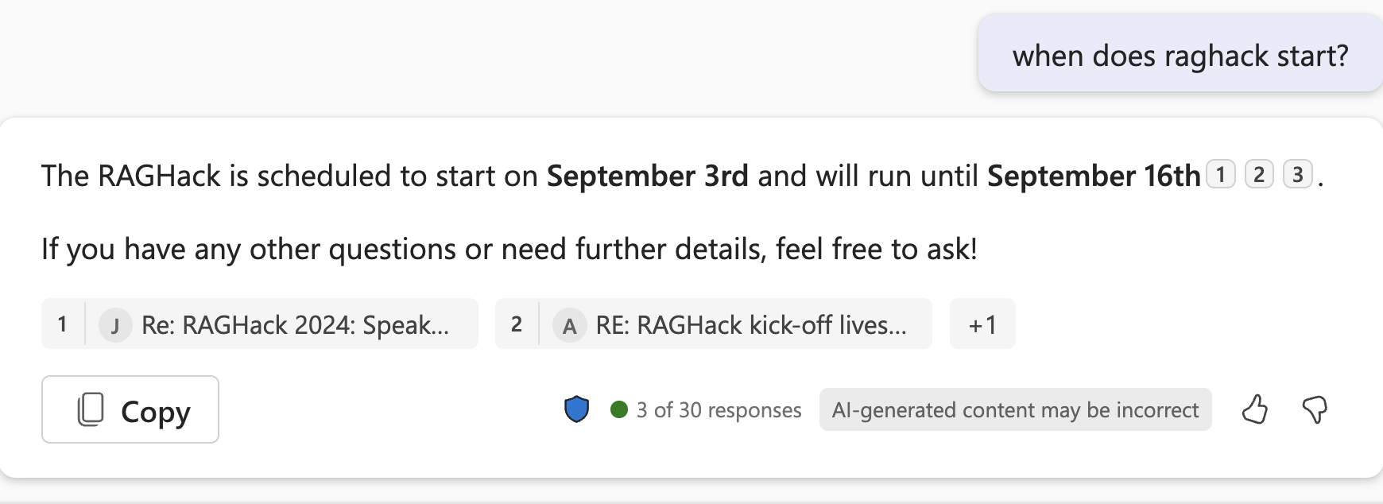
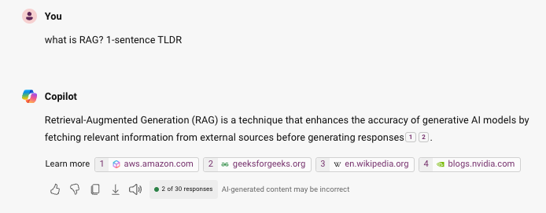
RAG in the wild
GitHub Copilot (RAG on your VSCode workspace)
Teams Copilot (RAG on your chats)
Bing Copilot
(RAG on the web)

Slide 22
Types of RAG

Slide 23
Types of RAG
RAG flows:
Simple RAG
Advanced RAG with Query rewriting
RAG sources:
Structured data (DB tables)
Documents (PDF, MD, etc.)
GraphRAG

Slide 24
Simple RAG
For great hiking shoes, consider the TrekExtreme Hiking Shoes ¹ or the Trailblaze Steel-Blue Hiking Shoes ²
What's the best shoe
for hiking?
[101]:
Name: TrekExtreme Hiking Shoes Price: 135.99
Brand: Raptor Elite
Type: Footwear
Description: The Trek Extreme hiking shoes by Raptor Elite are built to ensure any trail.
…
User
Question
Search
Large Language Model

Slide 25
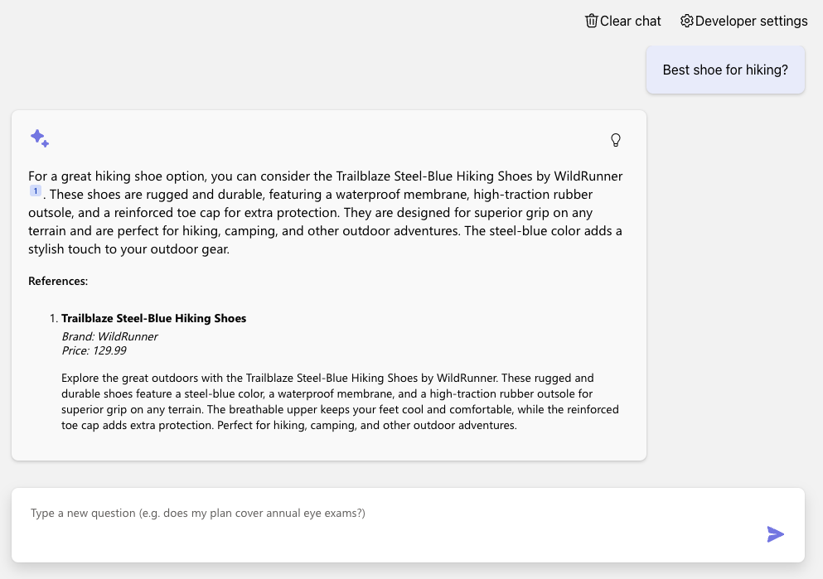
Simple RAG (on PostgreSQL)
Azure OpenAI +
Azure PostgreSQL Flexible Server +
Azure Container Apps
Code:
aka.ms/rag-postgres
Demo:
aka.ms/rag-postgres/demo

Slide 26
Advanced RAG with query re-writing
For great hiking shoes, consider the TrekExtreme Hiking Shoes ¹ or the Trailblaze Steel-Blue Hiking Shoes ²
what's a good shoe for a mountain trale?
mountain trail shoe
[101]:
Name: TrekExtreme Hiking Shoes Price: 135.99
Brand: Raptor Elite
Type: Footwear
Description: The Trek Extreme hiking shoes by Raptor Elite are built to ensure any trail.
…
User
Question
Large Language Model
Search
Large Language Model

Slide 27
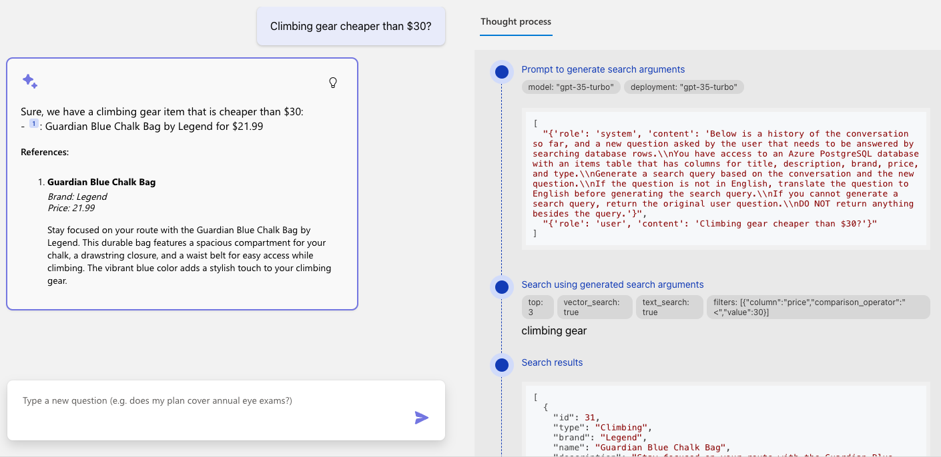
Advanced RAG (on PostgreSQL)

Slide 28
Query rewriting with function calling
Do you sell climbing gear cheaper than $30?
search_database(
"climbing_gear",
{"column": "price",
"operator" : "<",
"value" : "30"
}
)
Large Language Model with function calling
User
Question
Notes:
TODO: live-demo a brand filter

Slide 29
Advanced RAG with query rewriting via function calling
We offer 2 climbing bags for your budget:
SummitStone Chalk Bag ¹
Guardian Blue Chalk Bag ²
Do you sell climbing gear cheaper than $30?
“Do you sell…”
price < 30
“Do you sell…”
“climbing gear”
[12]:
Name: SummitStone Chalk Bag Price:29.99
Brand:Grolltex
Type:Climbing
Description: The SummitStone Chalk Bag in forest green is a must-have for climbers seeking adventure.
…
User
Question
LLM
with function calling
Search
LLM

Slide 30
RAG on documents
Yes, your company perks cover underwater activities such as scuba diving lessons ¹
Do my company perks cover underwater activities?
PerksPlus.pdf#page=2: Some of the lessons covered under PerksPlus include: · Skiing and snowboarding lessons · Scuba diving lessons · Surfing lessons · Horseback riding lessons These lessons provide employees with the opportunity to try new things, challenge themselves, and improve their physical skills.….
User
Question
Search
Large Language Model

Slide 31
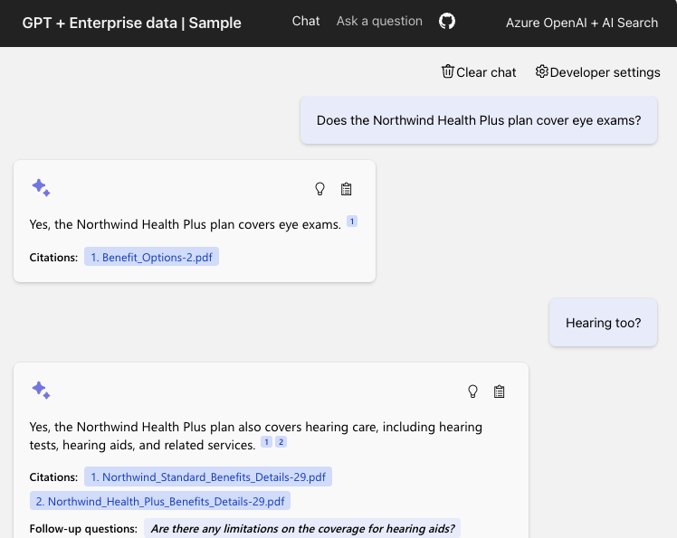
RAG on documents
Azure OpenAI +
Azure AI Search +
Azure App Service
Supports simple and advanced flows
(Ask tab vs. Chat tab)
Code:
aka.ms/ragchat
Demo:
aka.ms/ragchat/demo

Slide 32


RAG data sources
Database rows
(Structured data)
Documents
(Unstructured data)
PDFs, docx, pptx, md, html, images
You need a way to vectorize & search target columns.
PostgreSQL + pgvector
Azure SQL + vector search (upcoming)
Cosmos MongoDB + vector
You need an ingestion process
for extracting, splitting, vectorizing,
and storing document chunks.
Azure AI Search +
Integrated Vectorization
Document Intelligence or

Slide 33
Building a RAG app

Slide 34
RAG components
Component | Examples
Retriever: A knowledge base that can efficiently retrieve sources that match a user query (Ideally supports both vector and full-text search) | Azure AI Search, Azure CosmosDB, PostgreSQL, Qdrant, Pinecone
LLM: A model that can answer questions based on the query based on the provided sources, and can include citations | OpenAI: GPT 3.5, GPT 4, GPT-4o Azure AI Studio: Meta Llama3, Mistral, Cohere R+
Orchestrator (optional): A way to organize calls to the retriever and LLM | Community: Langchain, Llamaindex Microsoft: Semantic Kernel, Promptflow
Features | Chat history, Feedback buttons, Text-to-speech, User login, File upload, Access control, etc.

Slide 35
Many ways to build a RAG app
Copilot studio
Azure Studio On Your Data
Open source solutions
No Code
Low Code
High Code

Slide 36
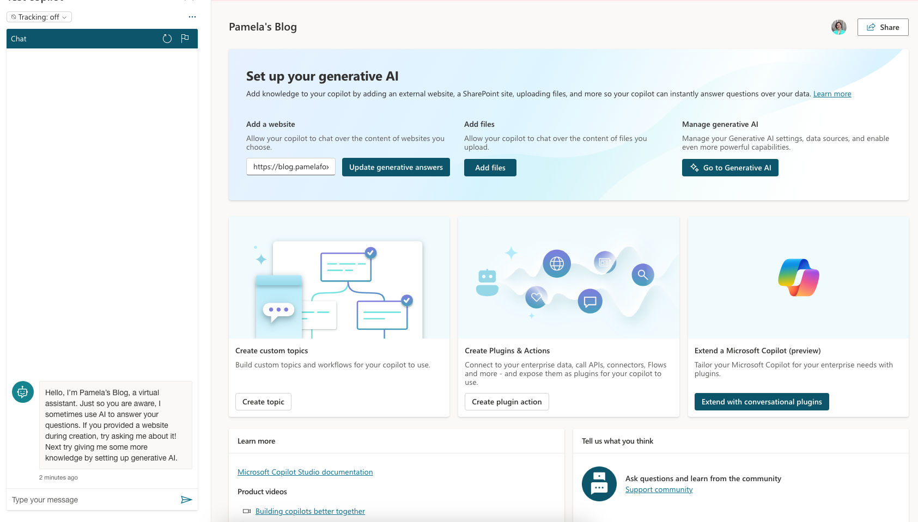
Copilot Studio
Retriever:
Uploaded files
LLM: GPT 3.5, GPT 4
https://copilotstudio.preview.microsoft.com/

Slide 37
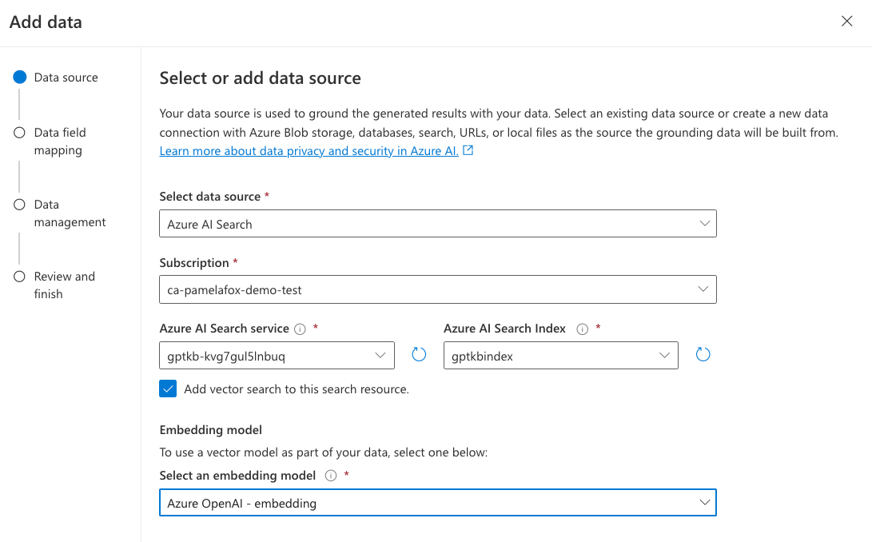
Azure OpenAI Studio – On Your Data
Retriever:
Azure AI Search
Azure Blob Storage
Azure CosmosDB for MongoDB vCore
URL/Web address
Uploaded files
LLM: GPT 3.5/4
Features:
User authentication
Chat history persistence
https://learn.microsoft.com/azure/ai-services/openai/concepts/use-your-data

Slide 38

Open-source RAG chat app: Python
Retriever:
Azure AI Search
LLM: GPT 3.5/4
Features:
Multi-turn chats
User authentication with ACLs
Chat with image documents
"Building RAG apps in Python"
September 3, 10:00 PM UTC / 03:00 PM PT
aka.ms/raghack/python
github.com/Azure-Samples/azure-search-openai-demo

Slide 39
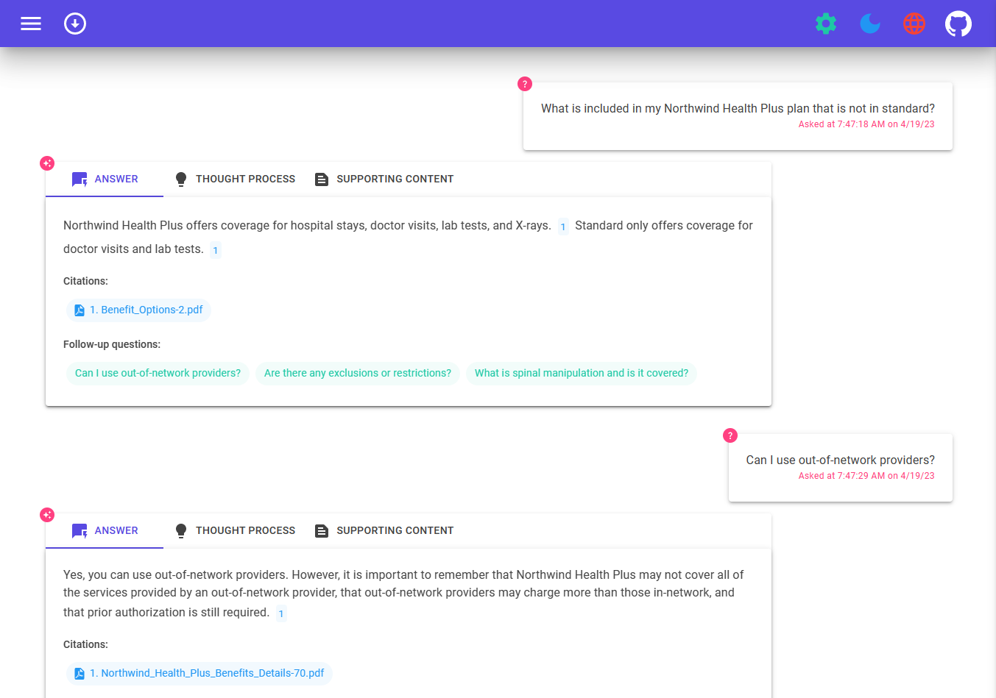
Open-source RAG chat app: .NET
Retriever: Azure AI Search
LLM: GPT 3.5/4
Orchestrator: Semantic Kernel
Features:
Voice chat
"Building RAG apps in .NET"
Sept. 3, 6:00 PM UTC / 11:30 AM PT
aka.ms/raghack/dotnet
github.com/Azure-Samples/azure-search-openai-demo-csharp

Slide 40
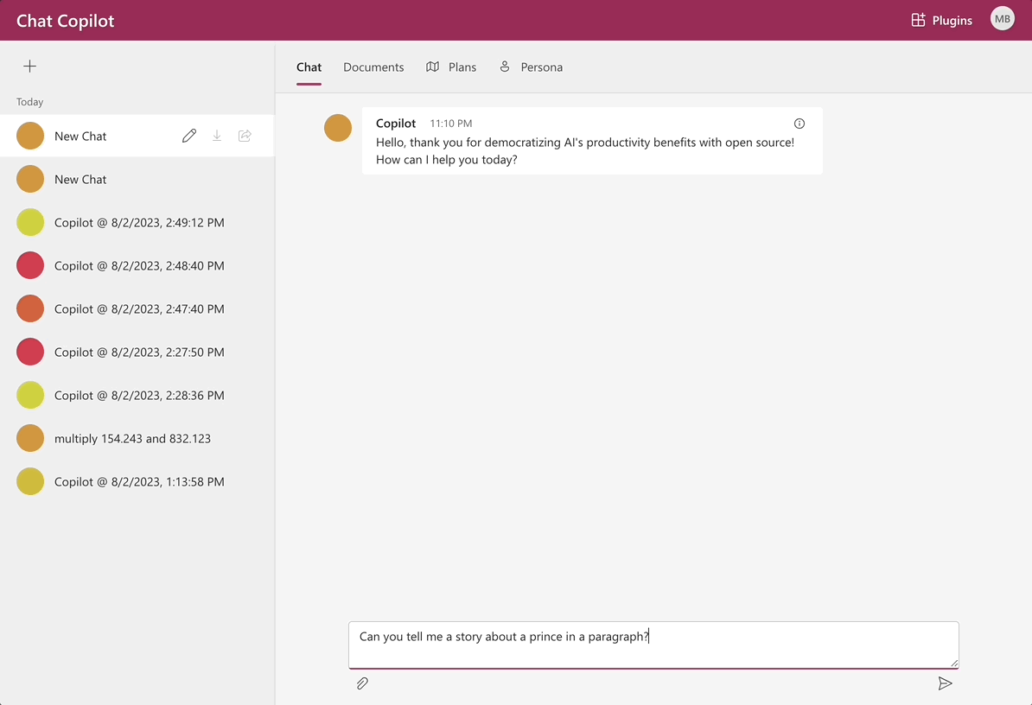
Open-source RAG chat app: .NET
Retriever: Azure AI Search
LLM: GPT 3.5/4
Orchestrator: Semantic Kernel
Features:
User uploaded documents
Collaborative chat
Conversation history
https://github.com/microsoft/chat-copilot

Slide 41
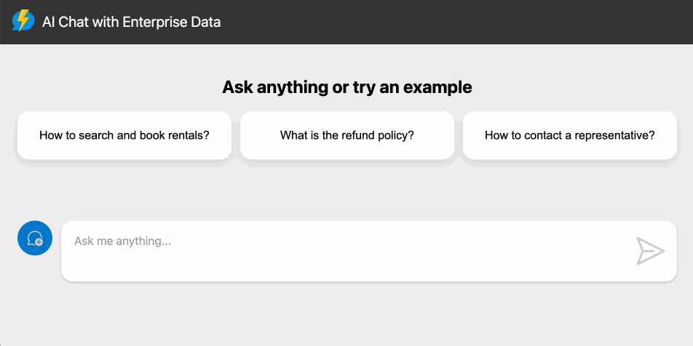
Open-source RAG chat app: JavaScript
Retriever: Cosmos DB for NoSQL
LLM: GPT 3.5/4
Orchestrator: Langchain.JS
Features:
Serverless architecture (Azure Functions)
"Building RAG apps in Langchain.JS"
September 4, 3:00 PM UTC / 8:00 AM PT
aka.ms/raghack/js
https://github.com/Azure-Samples/serverless-chat-langchainjs

Slide 42
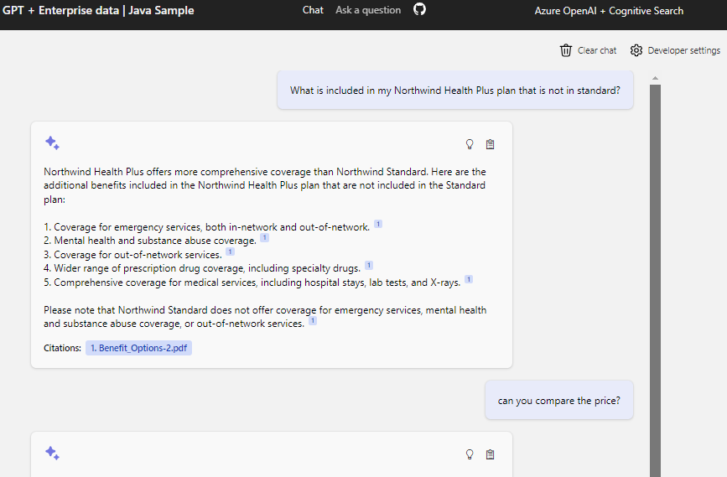
Open-source RAG chat app: Java
Retriever: Azure AI Search
LLM: GPT 3.5/4
Orchestrator: Semantic Kernel
"Building RAG apps with
Java + Semantic Kernel"
Sept. 9, 3:00 PM UTC / 8:00 AM PT
aka.ms/raghack/java-sk
https://github.com/Azure-Samples/azure-search-openai-demo-java/

Slide 43
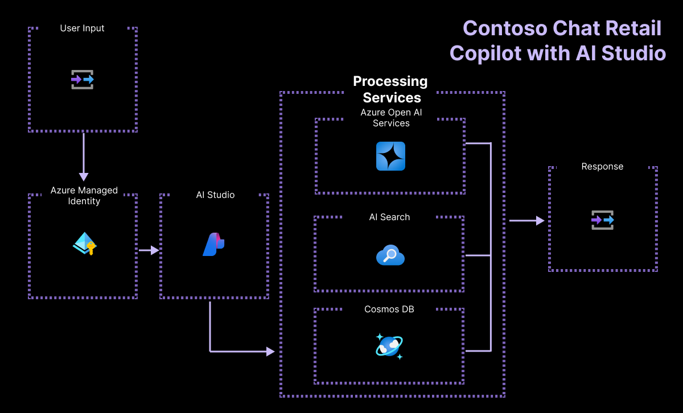
Open-source RAG chat solution: Azure AI Studio
Retriever: Azure AI Search
LLM: GPT 3.5/4
Orchestrator: PromptFlow
Features:
CosmosDB user info lookup
"Building RAG apps with
Java + Semantic Kernel"
Sept. 9, 3:00 PM UTC / 8:00 AM PT
aka.ms/raghack/aistudio
https://github.com/Azure-Samples/contoso-chat

Slide 44
RAG app solution: Deep dive

Slide 45
Prerequisites
Azure account and subscription
A free account can be used, but will have limitations.
Access to Azure OpenAI or an openai.com account
Azure account permissions:
Microsoft.Authorization/roleAssignments/write
Microsoft.Resources/deployments/write on subscription level
https://github.com/Azure-Samples/azure-search-openai-demo/#azure-account-requirements

Slide 46
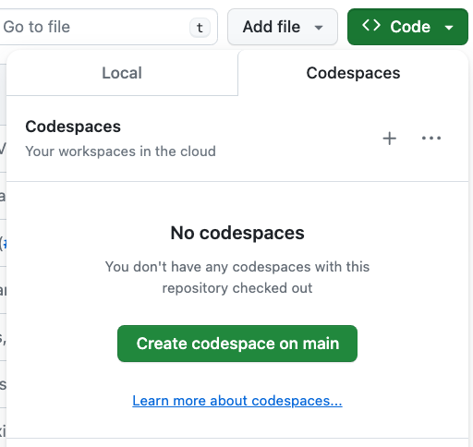
Opening the project: 3 options
GitHub Codespaces →
VS Code with Dev Containers extension
Your Local Environment
Python 3.9+
Node 14+
Azure Developer CLI
https://github.com/Azure-Samples/azure-search-openai-demo/?tab=readme-ov-file#project-setup

Slide 47
Deploying with the Azure Developer CLI
Login to your Azure account:
azd auth login --use-device-code
Create a new azd environment: (to track deployment parameters)
azd env new
Provision resources and deploy app:
azd up
💸 Deploy with free tiers following guide @ aka.ms/ragchat/free

Slide 48





Application architecture on Azure
DATA INGESTION
Integrated vectorization
or
Local script
Azure Storage
Document
Intelligence
Python
Azure OpenAI
Azure
AI Search
Uploads PDF pages
Extracts data from PDFs
Splits data
into chunks
Computes embeddings
Stores in index
Azure
App Service
or
Local server
CHAT APP
Azure Storage
Azure OpenAI
Azure
AI Search

Slide 49
Code walkthrough
Typescript frontend
(React, FluentUI)
Python backend
(Quart, Uvicorn)
chat.tsx
makeApiRequest()
api.ts
chatApi()
app.py
chat()
chatreadretrieveread.py
run()
get_search_query()
compute_text_embedding()
search()
get_messages_from_history()
chat.completions.create()

Slide 50
Search approach
Reranking
For optimal retrieval, search() uses hybrid retrieval (text + vectors) plus the semantic ranker option.
Fusion (RRF)
https://aka.ms/ragrelevance
Vector
Keywords
"Production-ready RAG with Azure AI Search"
Sept. 5, 7:00 PM UTC / 12:00 PM PT
aka.ms/raghack/aisearch

Slide 51
Customizing the RAG app
Adding your own data
Local development
Customizing the frontend (UI)
Customizing the backend

Slide 52
Adding your own data
Remove existing sample data:
Add new documents to /data folder
Add new data
./scripts/prepdocs.sh --removeall
./scripts/prepdocs.sh
🔗 Data ingestion guide: Removing documents aka.ms/ragchat/remove-data
Notes:
Demo!

Slide 53
Starting the local server
cd app
./start.sh
Packages the React frontend typescript files using vite
Copies the JS into app/backend folder
Starts the Python app in reload mode (which only watches Python files!)
localhost:50505
cd app/frontend
npm run dev
Runs the frontend with hot reloading
localhost:5173

Slide 54
Customizing the frontend
Change this file: | To customize:
app/frontend/index.html | title, metadata, script tag
app/frontend/public/favicon.ico | browser tab icon
app/frontend/src/pages/layout/Layout.tsx | Navigation bar, colors
app/frontend/src/pages/chat/Chat.tsx | “Chat” tab and default settings
app/frontend/src/pages/ask/Ask.tsx | “Ask” tab and default settings

Slide 55
Customizing the backend
Change this file: | To customize:
app/backend/app.py | additional routes, app configuration
app/backend/approaches/chatreadretrieveread.py | “Chat” tab, RAG prompt and flow
app/backend/approaches/chatreadretrievereadvision.py | “Chat” tab, RAG flow when using vision
app/backend/approaches/retrievethenread.py | “Ask” tab, RAG prompt and flow
app/backend/approaches/retrievethenreadvision.py | “Ask” tab, RAG flow when using vision

Slide 56
Changing the prompt
Assistant helps the company employees with their healthcare plan questions, and questions about the employee handbook. Be brief in your answers.
Answer ONLY with the facts listed in the list of sources below. If there isn't enough information below, say you don't know. Do not generate answers that don't use the sources below. If asking a clarifying question to the user would help, ask the question.
For tabular information return it as an html table. Do not return markdown format. If the question is not in English, answer in the language used in the question.
Each source has a name followed by colon and the actual information, always include the source name for each fact you use in the response. Use square brackets to reference the source, for example [info1.txt]. Don't combine sources, list each source separately, for example [info1.txt][info2.pdf].

Slide 57
RAGHack: Next steps
aka.ms/raghack
Register for the hackathon @ aka.ms/raghack/register
Hack, hack, hack! Try our code samples or start from scratch!🧑🏿‍💻 👩🏻‍💻 👩🏼‍💻
For any questions, post in GitHub forum or attend Discord Office Hours. 🙋🏼 🙋🏾‍♀️
Join more live RAG sessions! aka.ms/raghack/streams
Submit your project before September 16th 11:59 PM PT to win prizes! 💵

Slide 58
Advanced RAG example: GitHub Copilot for Azure
Private Preview

Slide 59
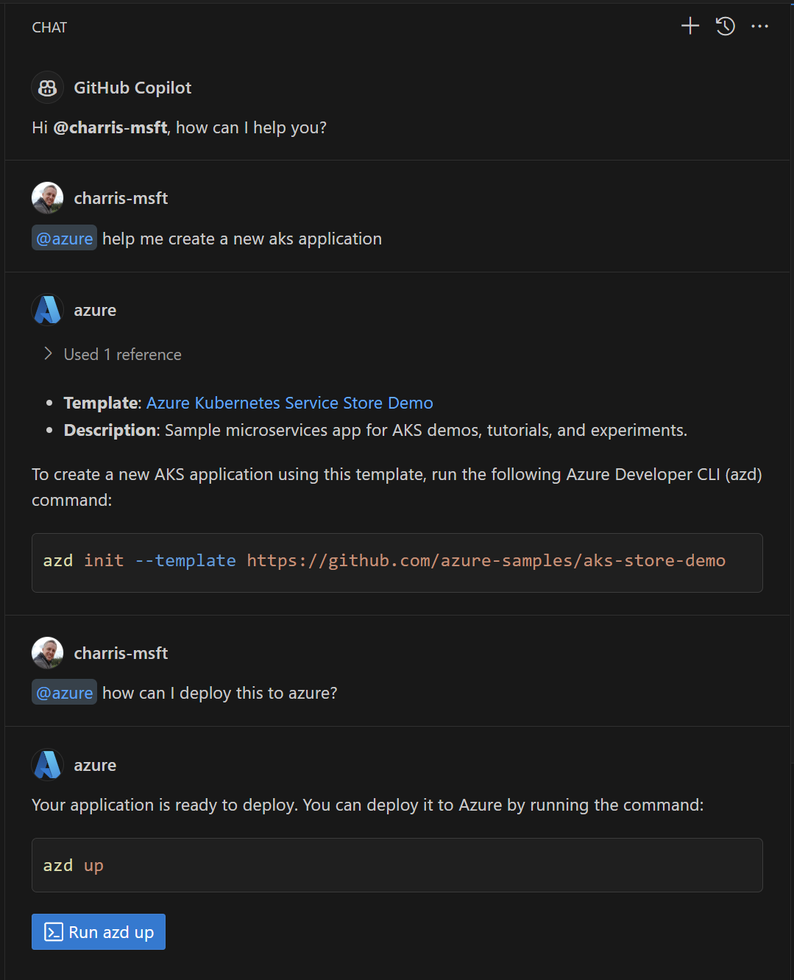
GitHub Copilot for Azure (@azure)
Helps developers in VS Code
learn about Azure services and how to use, deploy and manage them
find and deploy application templates quickly and easily to Azure
diagnose and troubleshoot application issues
work independently, minimizing reliance on senior team members and devops
https://aka.ms/GitHubCopilotForAzure

Slide 60
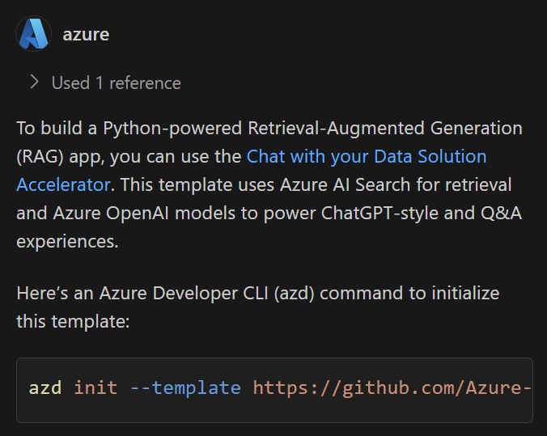


Architecture
@azure help me build a python-powered RAG app
User Prompt + Function definitions
1
"Call Template Recommender"
2
Template Recommender Service
Orchestrator
3
Large Language Model
[{"name": "Chat with...
"url": "https://github...
...
}]
Notes:
The Orchestrator first calls the LLM with the User Prompt and a list of functions that can be used to help. Then it calls the function recommended by the LLM, the Template Recommender Service.
Then it calls the LLM again with the User Prompt and the response from the Template Recommender to generate the response for the user.

Slide 61
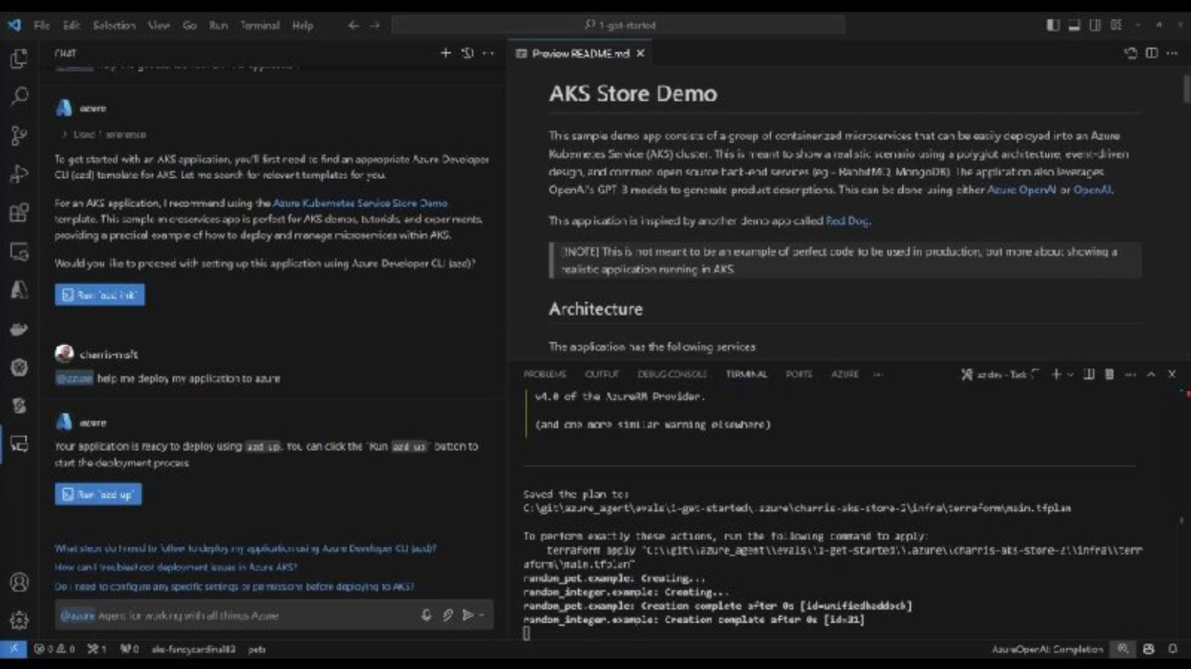
13 min Demo: Deploying AZD with Troubleshooting

